Slide 1
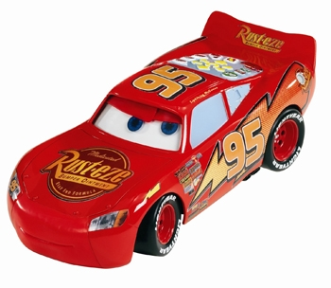
By the end of this lesson you should be able to understand:
what a data capture form is
what a data capture form can be used
for
and be able to create a well designed,
suitable data capture form

Slide 2
How to achieve Your Levels
To achieve a level 3 you should finish your data capture form
To achieve a level 4 you should finish your data capture form and your form should be suitable for someone that works in the police to conduct an investigation. It should include a logo and look professional.
To achieve a level 5 your data capture form should cover the above but also be easy to use for anyone that needs to fill it in.

